Slide 1

Deep learning and Neural Networks: Overview
Track module I
Ekaterina Golubeva
20.01.23

Slide 3
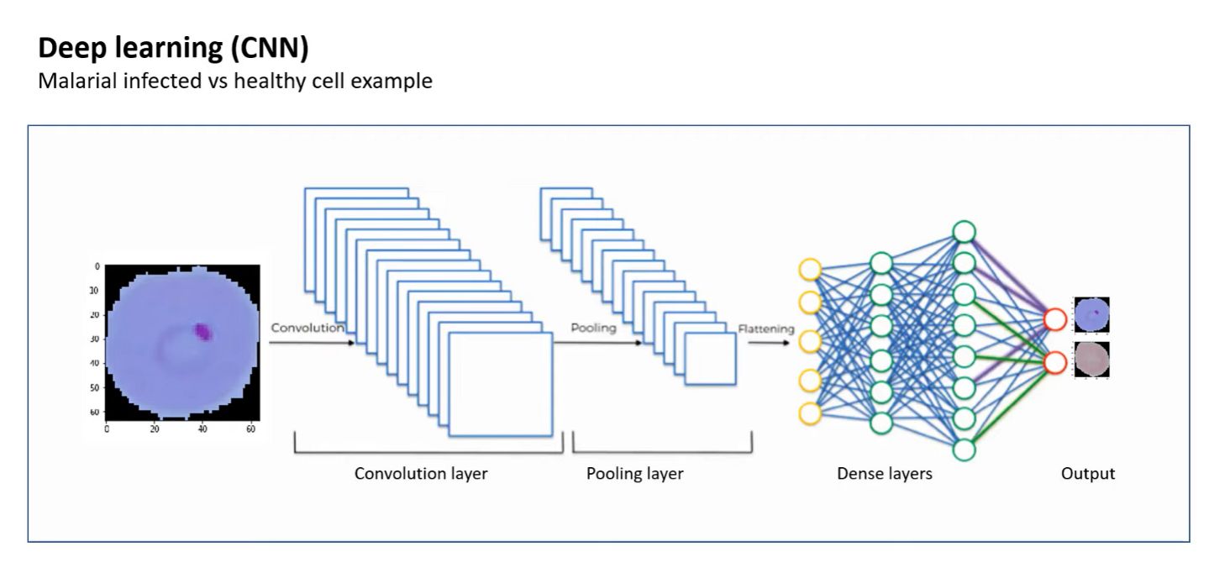

Slide 5
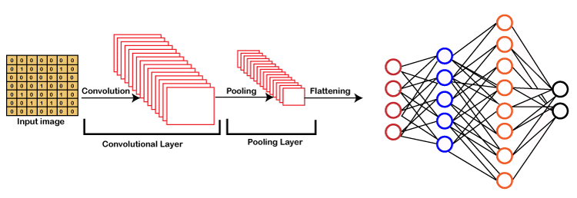
Key words to understand

Slide 6
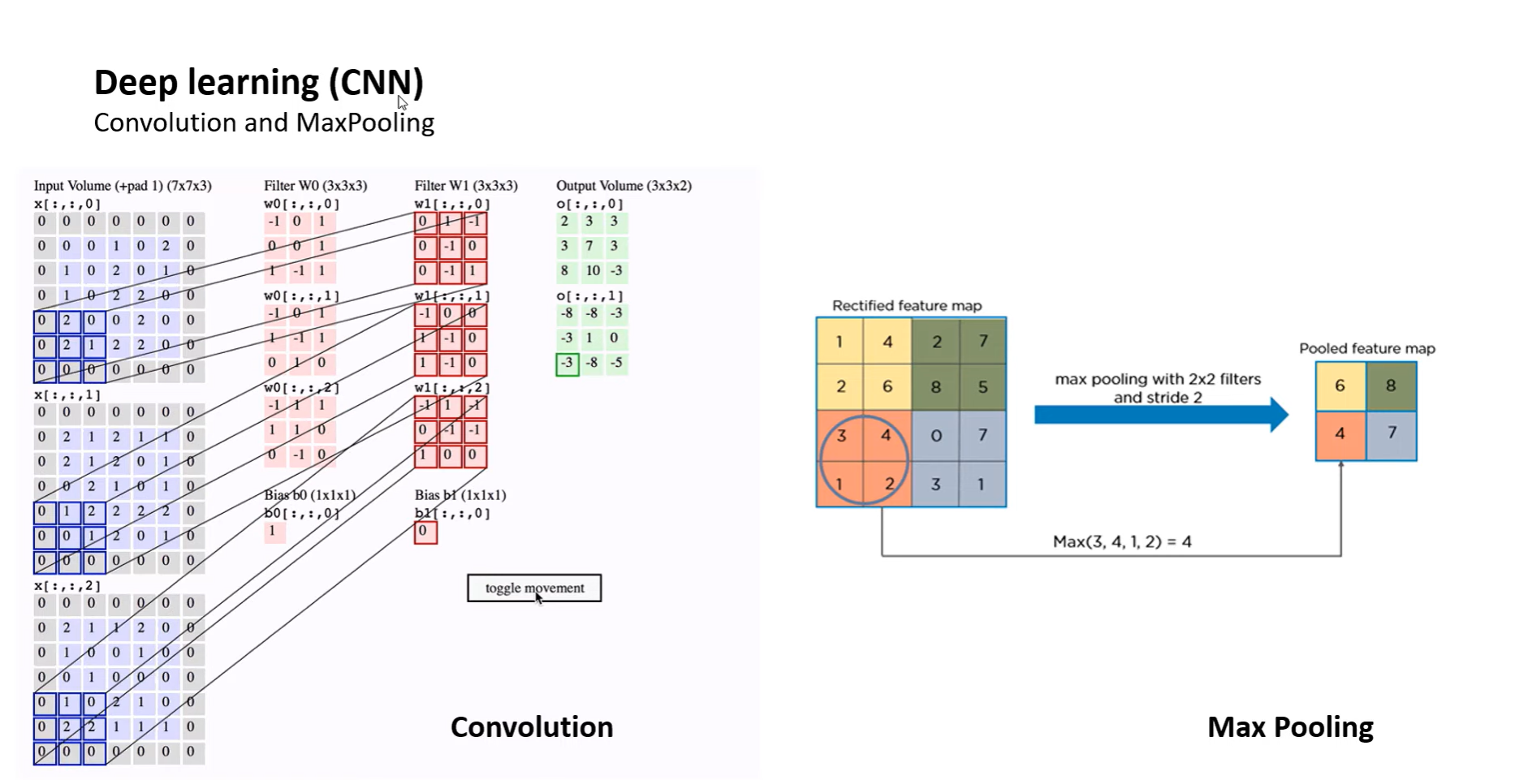

Slide 9
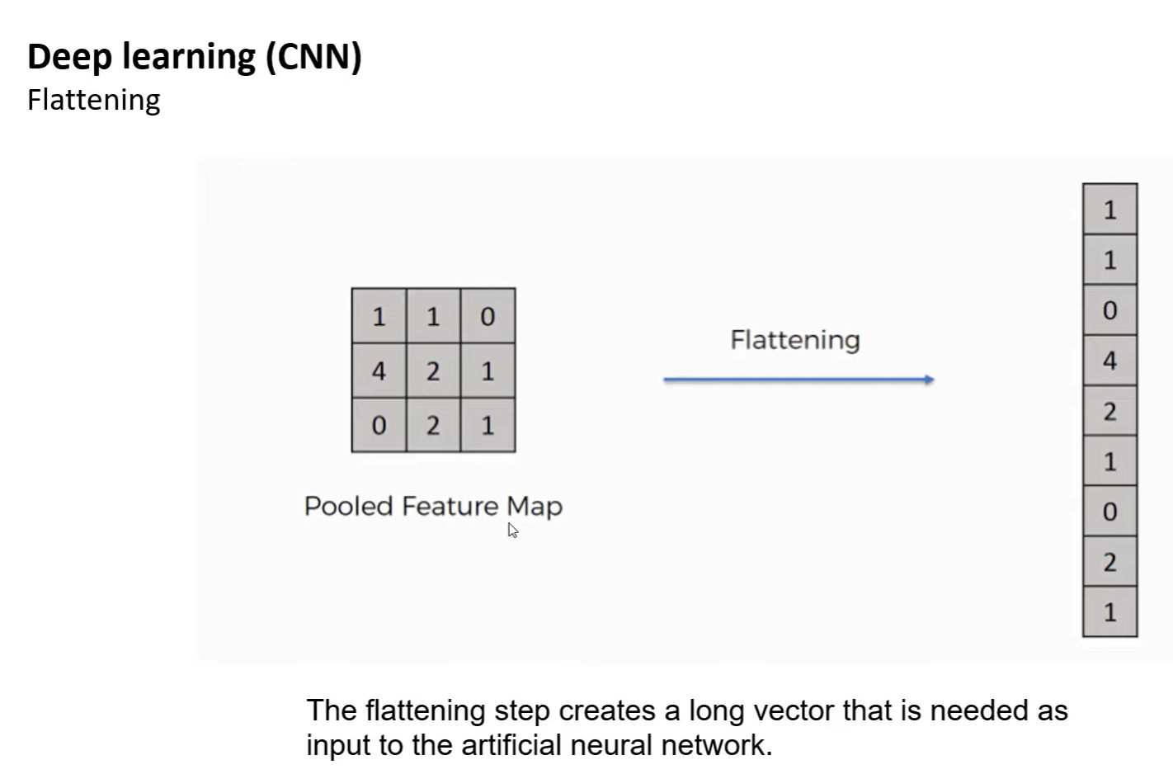

Slide 10
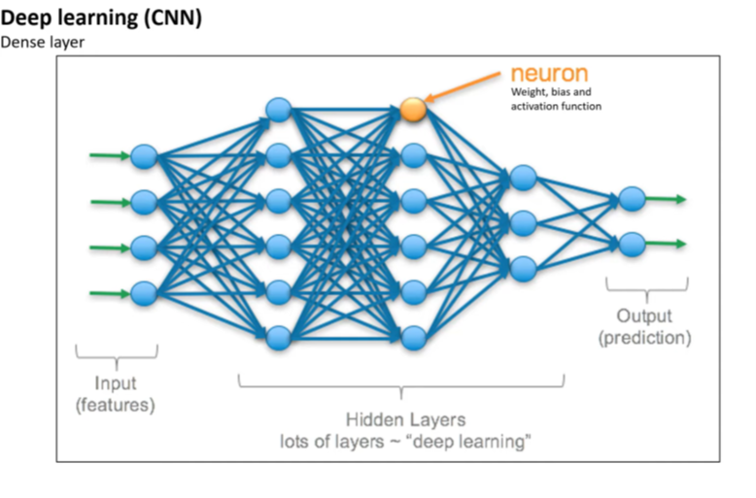

Slide 11
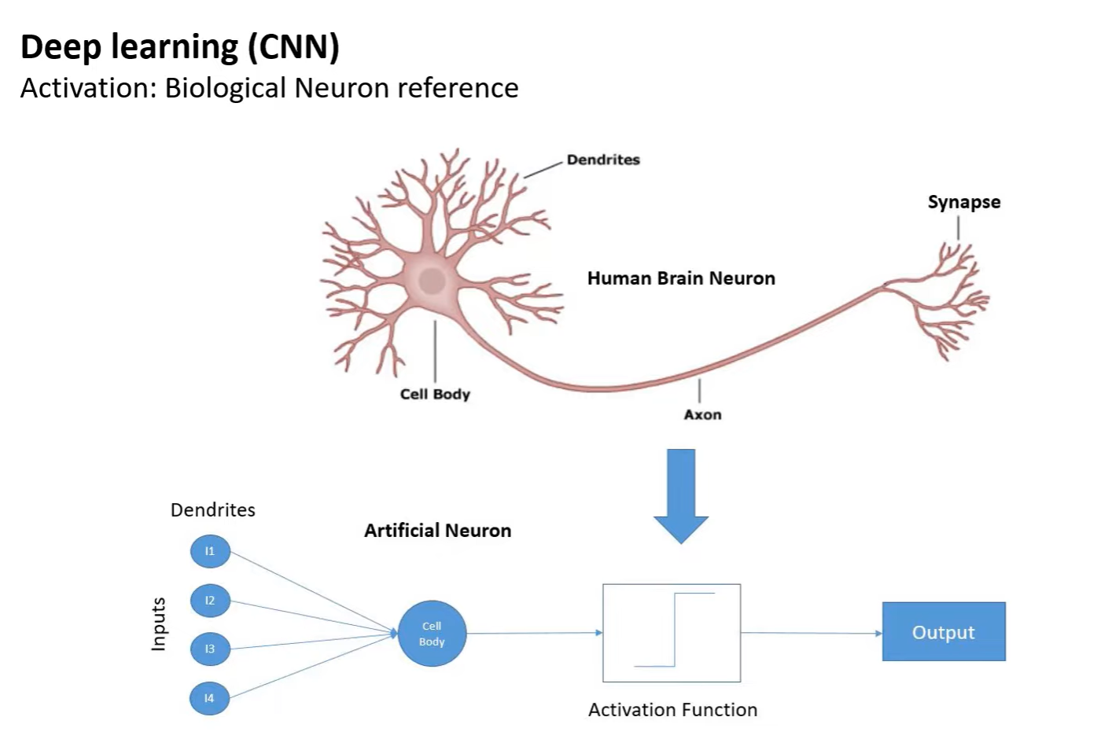

Slide 12
Activation functions and optimizers

Slide 13
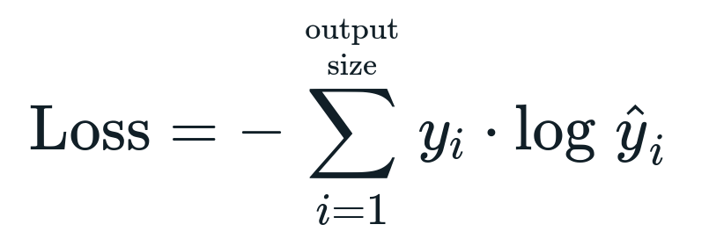
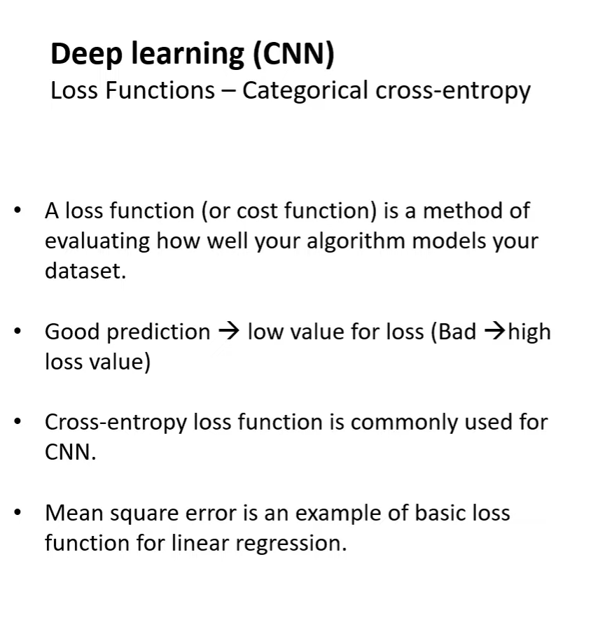
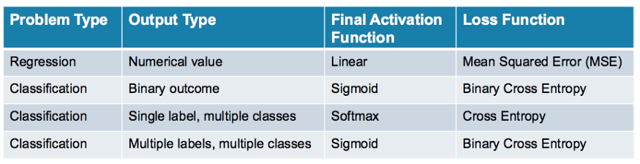

Slide 15
Workflow and implementation
Design the network
Define images (add labels)
Split dataset into training and testing sets
Fit the model
Plot model accuracy, model.evaluate to monitor CNN’s performance

Slide 16
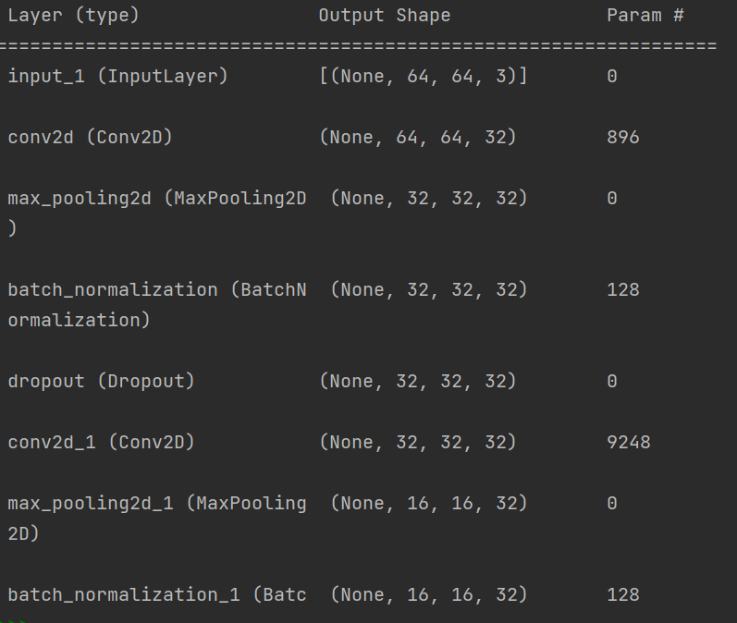
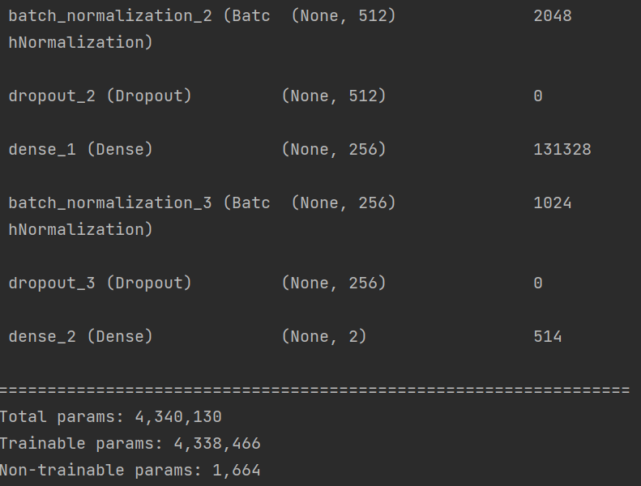
Model summary

Slide 17
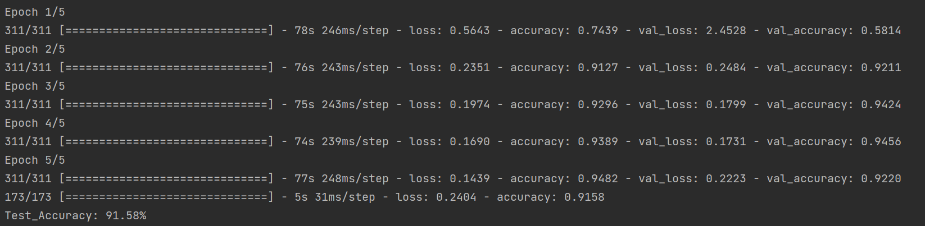
Model fitting

Slide 18
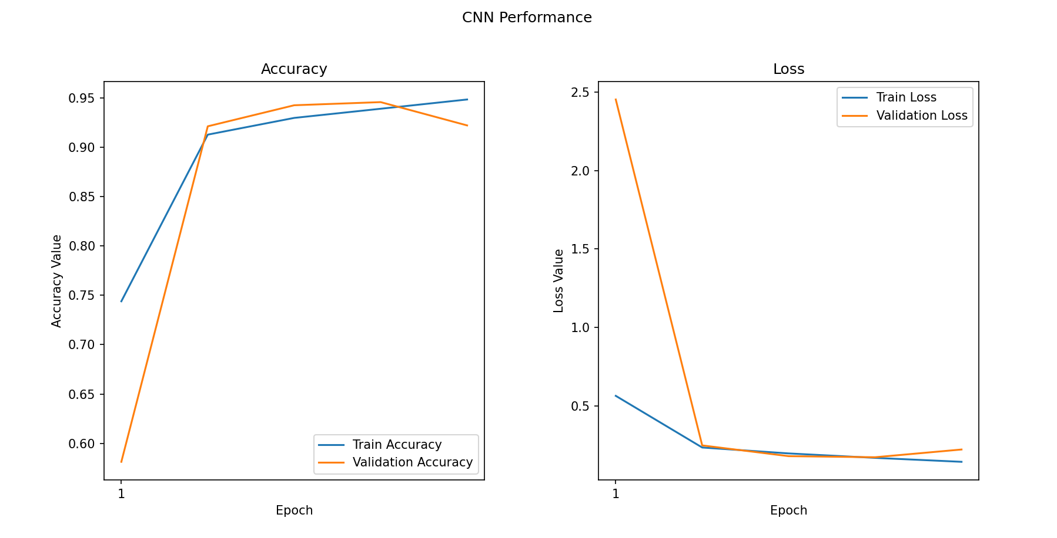

Slide 19
Lessons learnt
Take subset of a big dataset to experiment easily, otherwise it is very time-consuming
Bigger number of epoch improves accuracy
Further research
Understand what neurons are
Understand what parameters are (number of neurons, weights …?

Slide 20
Command | Description
inp = keras.layers.Input(shape=INPUT_SHAPE) | Define input
conv=keras.layers.Conv2D(32,kernel_size=(3,3),activation='relu', padding='same')(inp) | Define convolutional layer, activation function, apply to the input layer
pool=keras.layers.MaxPooling2D(pool_size=(2, 2))(conv) | Define pooling layer, apply to the convolutional layer
norm = keras.layers.BatchNormalization(axis=-1)(pool) | Define normalization, apply to previous layer
drop = keras.layers.Dropout(rate=0.2)(norm) | Define dropout, give the percent of data to be dropped, apply to previous layer
flat = keras.layers.Flatten()(drop) | Flatten the matrix to get it ready for dense layer
hidden=keras.layers.Dense(512, activation='relu')(flat) | Defin dense layer, activation function, apply to flattened data
out=keras.layers.Dense(2,activation='sigmoid')(drop4) | Define output from dense layer
model = keras.Model(inputs=inp, outputs=out) | Defin the model using input and output
model.compile(optimizer='adam', loss='categorical_crossentropy', metrics=['accuracy']) | Define model parameters such as optimizer, loss function to be minimized at each epoch and evaluation metrics.
print(model.summary() | Model summary gives shape at each layer and number of parameters
history = model.fit(np.array(X_train), y_train, batch_size=64,# 64 images at a tim, verbose=1, epochs=5, # validation_split=0.1, # 10% for validation, shuffle=False) | Fit the model
print("Test_Accuracy:{:.2f}%".format(model.evaluate(np.array(X_test), np.array(y_test))[1] * 100)) | Plot accuracy of the model

